Slide 1
Information Service on
Wholesale Market Price & Distribution
for Farmers to Make Reasonable Decisions on Shipment
Kwon Mina, (alsdk358@epis.or.kr)
Smart Policy Management Section
Korea Agency of Education, Promotion and Information Service in Food, Agriculture, Forestry and Fisheries
DATE: August 28, 2019

Slide 2
Contents
Ｉ. Purpose of wholesale market price information service
Ⅱ. Collection system of wholesale market price information
Ⅲ. Use cases of wholesale market price information
- 1 -

Slide 3
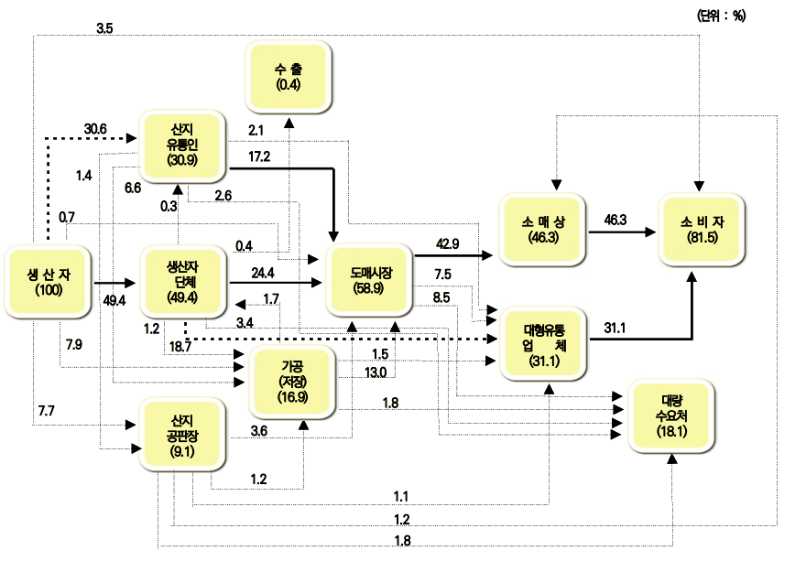
Ｉ. Purpose of wholesale market price information service
To enhance farmer’s bargaining power in the market and support decision making on shipment by opening the trade information on wholesale market
Functions of public agricultural wholesale market
Distribution channel of fruits and vegetables
in 2017 (Jan. 2019)
① Commercial distribution
- Forming price of agricultural product dealing, price settlement, financial function, and risk bearing
② Physical distribution
- Collecting, circulating, storing, conserving, loading and unloading, and transporting agricultural product
③ Distribution information
- Collecting and distributing market trends, price info, etc.
④ Supply and demand control
- Controlling supply and price by taking in or out the agricultural product
- 2 -

Slide 4
Ｉ. Purpose of wholesale market price information service
To enhance farmer’s bargaining power in the market and support decision making on shipment by opening the trade information on wholesale market
Functions of public agricultural wholesale market
60% of fruits and vegetables are traded through wholesale market in Korea
Auctioning price in the wholesale market is useful as a big data in the distribution of agricultural product
① Commercial distribution
- Forming price of agricultural product dealing, price settlement, financial function, and risk bearing
② Physical distribution
- Collecting, circulating, storing, conserving, loading and unloading, and transporting agricultural product
③ Distribution information
- Collecting and distributing market trends, price info, etc.
④ Supply and demand control
- Controlling supply and price by taking in or out the agricultural product
59
%
2017
61
%
2013
74
%
2007
- 2 -

Slide 5
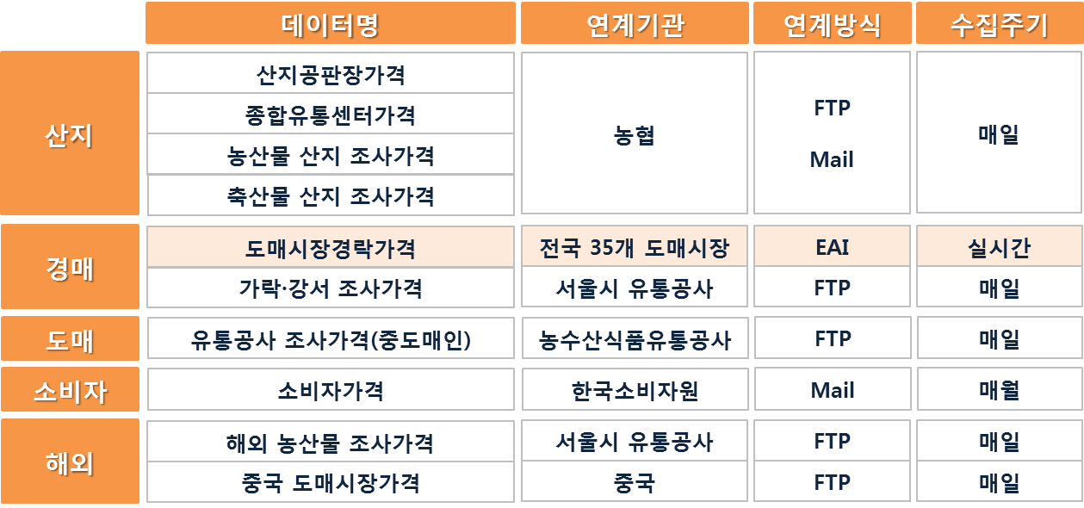
Ⅱ. Collection system of wholesale market price information
Collecting, managing, and sharing distribution price of agricultural product encompassing from place of origin to auctioning to wholesaling and to consumers
Operation status of EPIS price information on agricultural product
Collecting, managing, and sharing data
Producing and managing data
Using data
- 4 -

Slide 6
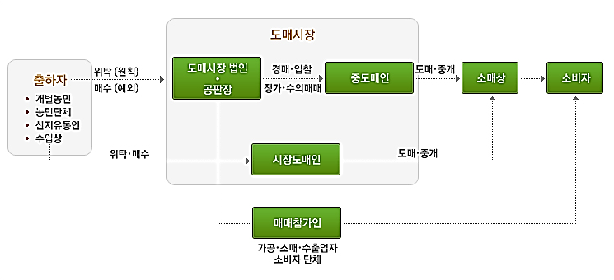
Ⅱ. Collection system of wholesale market price information
A real-time data production is possible as the price of agricultural product is decided through an e-auction at wholesale corporation
System chart of wholesale market trading
Flowchart of e-auction
Farmer
Wholesale Market Corp.
Confirming inventory
Making sales table
Auction (Bidding machine)
Shipping
Agricultural product
Winning bid
E-bidding
Sharing price (real-time)
Moderate buyer
Bidder
- 5 -

Slide 7
Ⅱ. Collection system of wholesale market price information
Real-time data link using EAI
Collecting/managing/sharing scheme of wholesale market price information
EAI : Enterprise Application Integration
A standardized solution has been distributed to wholesale market by conducting “Improvement Project on Transferring Auction Price in Wholesale Markets”
* 3 (2015) → 6 (2016) → 9 (2017)
Wholesale market (Corp. & Management Office)
User
EPIS
Info Release
Info Use
Corp. Auction System
Wholesale market
Ordinary monitoring system
Wholesale Market
Standardized Code
Standardized code management system
General public
Auction Trading
Link
Integrated distribution management system
Wholesale Market Corp.
Voluntary trading under set price
Gov’t/Institutions
Distribution Management System
Web Service Open API File
Standardized code secured data usage
Moderate Buyer
Statistics Management
Standardized code
Successful bid DB
Info Sharing System
Private firms
Designed to compare and analyze each data by using standardized codes defining market, corporation, item, unit, packing state, size, quality, and origin.
Production Point Joint Market
Correcting Sales Table
Source successful
bidding DB
Open successful
bidding info DB
Distributors
Retention status of wholesale market price information
Classification | Collector | Collecting Method | Period | Daily Avg. | Total
Real-time bidding price in wholesale market | Public wholesale markets (35 places) | EAI | Real-time | 120,000 cases | 0.43 billion cases
Settled bidding price in wholesale market |  | EAI | Daily | 140,000 cases | 0.59 billion cases
0 6 0 1 0 1
① Major classification: category
② Middle classification: item
③ Minor classification: variety
Jonathan(060101) : Fruits(06) + apple(01) + Jonathan(01)
- 6 -

Slide 8
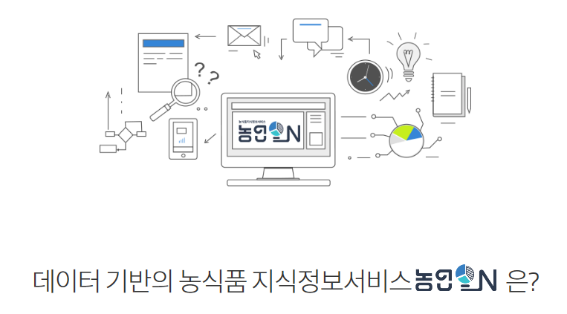
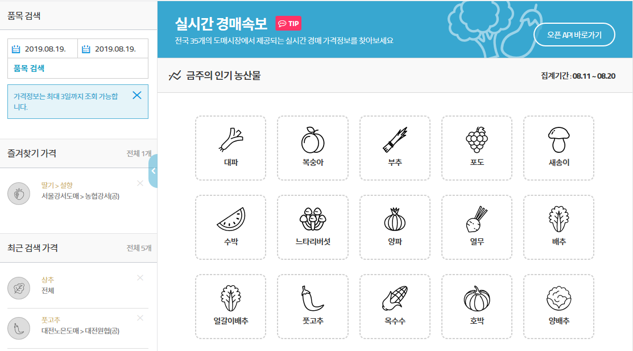
Ⅲ. Use cases of wholesale market price information
1. Offering simply price information : searching and comparison of prices by item and wholesale market
Delivering platform: www.agrion.kr
Shortcuts
Provides bookmark and recent search
An easy-to-use service channel where you can find data necessary to farming
Data and analysis information to catch up the trends are provided suitable for farmers
Even a beginning farmer can manage agriculture in a convenient and reasonable manner
- 7 -

Slide 9
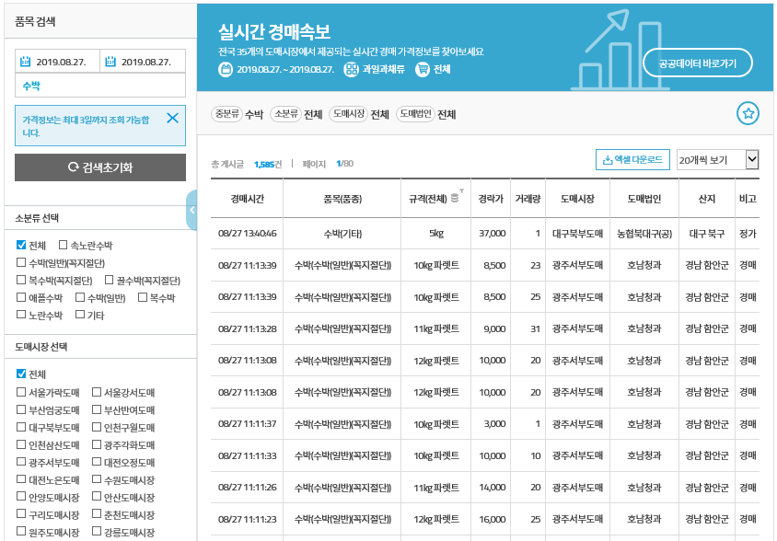
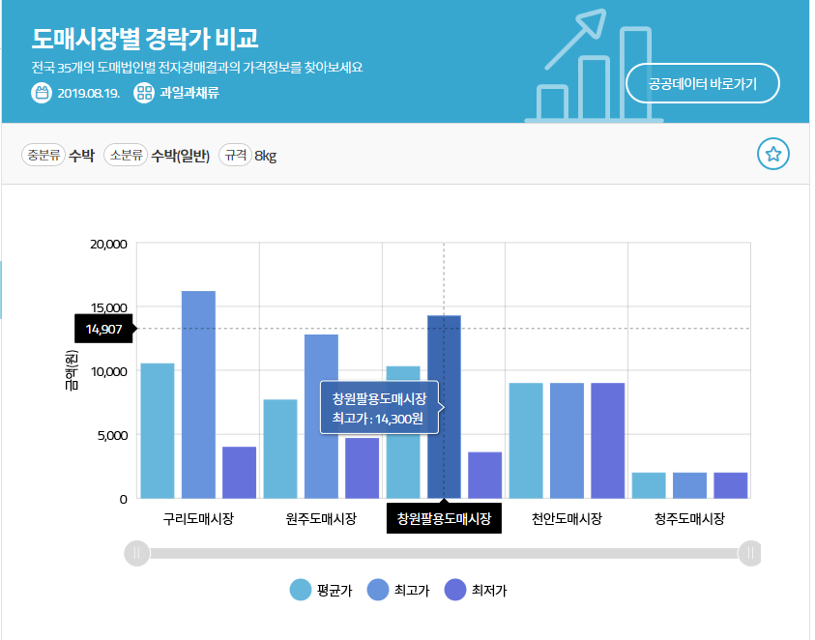
Ⅲ. Use cases of wholesale market price information
1. Offering simply price information : searching and comparison of prices by item and wholesale market
Delivering platform: www.agrion.kr
Provides a real-time raw data on price
Compares market price by item (average/maximum/minimum)
- 8 -

Slide 10
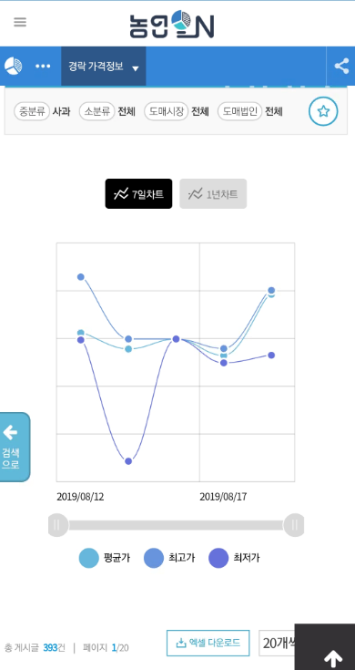
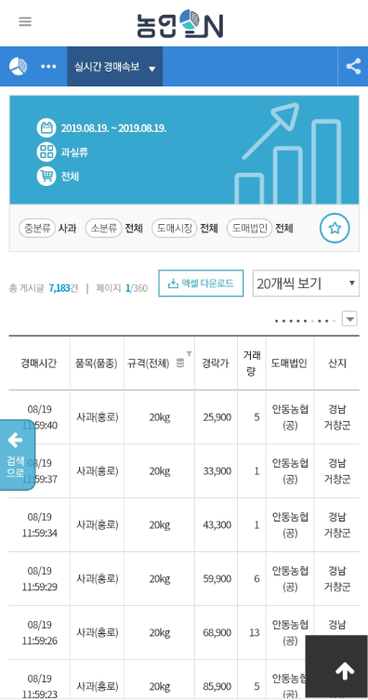
Ⅲ. Use cases of wholesale market price information
1. Offering simply price information : searching and comparison of prices by item and wholesale market
Delivering platform: www.agrion.kr
Provides price search on mobile
Provides a real-time raw data on price
- 9 -

Slide 11
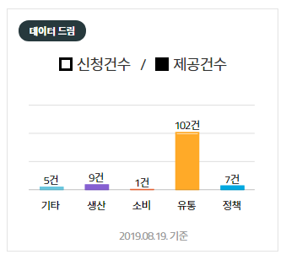
Ⅲ. Use cases of wholesale market price information
2. Use of price information: providing customized information and analysis information, and developing application
Data offering service: provides large and customized data
Use case
A study on price variation according to meteorological information, basic materials to set up a policy for standardized trading unit, reference materials for purchasing agricultural product, etc.
- 10 -

Slide 12
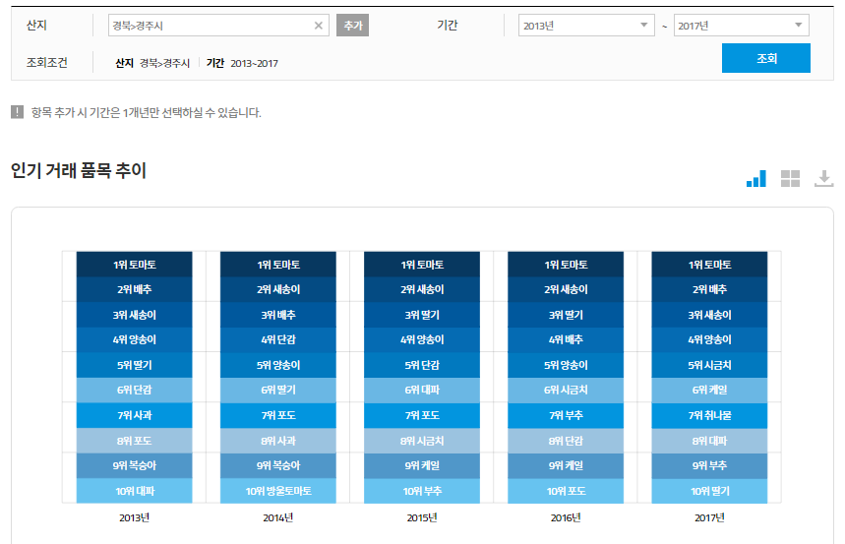
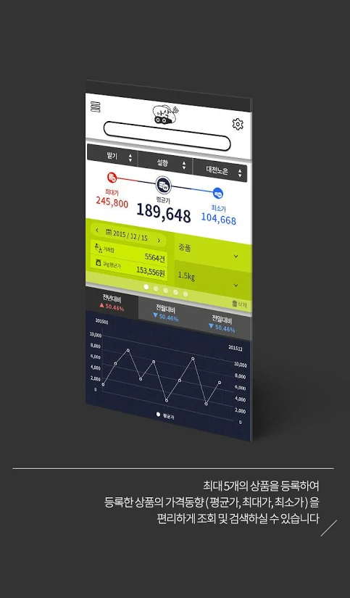
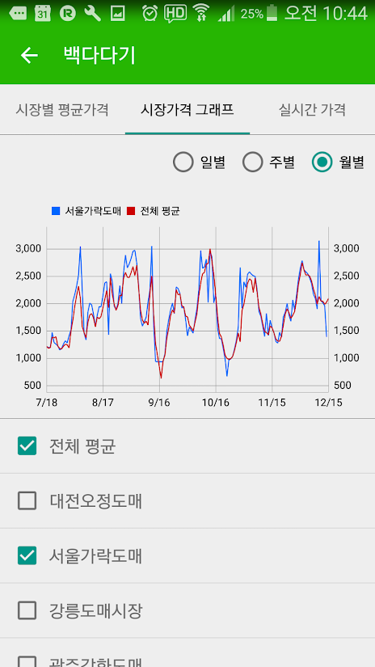
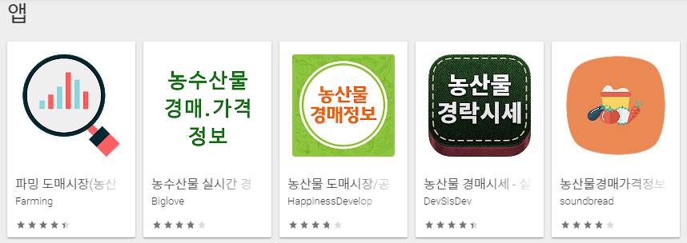
Ⅲ. Use cases of wholesale market price information
2. Use of price information: providing customized information and analysis information, and developing application
Data analysis service: analyzes hot items by origin and wholesale market
APP development for private sector: provides wholesale market price API
활용사례
- 11 -

Slide 13
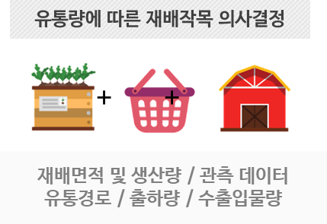
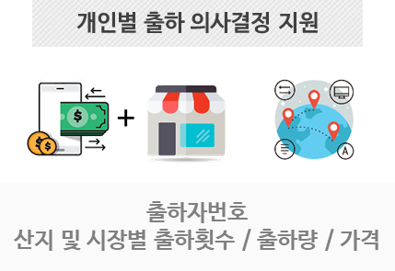
Ⅲ. Use cases of wholesale market price information
Expanding usage through controlling quality of wholesale market price data and identifying various kinds of analysis services
Supporting analysis use services
Considering user’s demand
Providing customized information to private firms
Supporting supply and demand and those who return to farming, and assisting data convergence such as GIS
Improving data quality
Less than 0.5% of error rate
Identifying personalized services including analyzing kinds of crops and shipment
Checking if price data standard is abided by
Refining error data and installing refined platform
Improving monitoring system
- 12 -

Slide 14
Thank You.
Kwon Mina, (alsdk358@epis.or.kr)
Smart Policy Management Section
Korea Agency of Education, Promotion and Information Service in Food, Agriculture, Forestry and Fisheries
DATE: August 28, 2019

